Slide 1
Big Mountain Review
Ticket price increase justification and pricing solution

Slide 2
The problem
Company
Context
Problem statement
Big Mountain is a ski resort in Montana. They see around 350000 visitors a year. They have 11 lifts, 2 T-bars, a longest run at 3.3 miles. The base elevation is 4464ft, summit is 6817ft with a vertical drop of 2,353 ft.
Big Mountain’s pricing strategy has been to charge a premium over the other resorts in their market, but would now like to revise that strategy by using data to decide if they should cut costs or raise ticket prices to increase revenue.
We have used a data-driven approach to reevaluate and develop a new pricing strategy. Through analysis of our data discoveries, we have figured out how they can restructure their pricing strategy and which features support it the most.

Slide 3
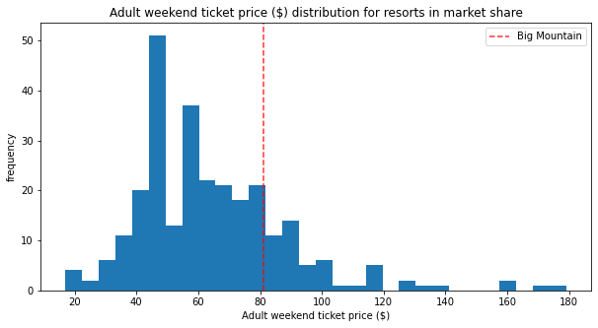
Solution 1
Through various comparison techniques, we discovered that Big Mountain Resort ticket price should be around $95.87, while the actual price is $81.00.
So while this could be off up to $10.39 because of a margin of error, it still suggests there is room for an increase.
Through various comparison techniques, we discovered that Big Mountain Resort ticket price should be around $95.87, while the actual price is $81.00.
So while this could be off up to $10.39 because of a margin of error, it still suggests there is room for an increase.
Through various comparison techniques, we discovered that Big Mountain Resort ticket price should be around $95.87, while the actual price is $81.00.
So while this could be off up to $10.39 because of a margin of error, it still suggests there is room for an increase.
Through various comparison techniques, we discovered that Big Mountain Resort ticket price should be around $95.87, while the actual price is $81.00.
So while this could be off up to $10.39 because of a margin of error, it still suggests there is room for an increase.
The following slides will show how Big Mountain compares with other resorts and how their features also justify this price increase

Slide 4
The resort operates within a market where people pay more for certain facilities, and less for others.The following features came up as important in our data modeling:
vertical_drop
Snow Making_ac
total_chairs
fastQuads
Runs
LongestRun_mi
trams
SkiableTerrain_ac

Slide 5
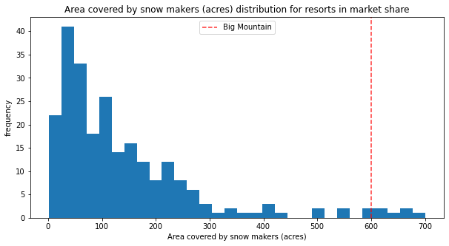
Snow Makers

Slide 6
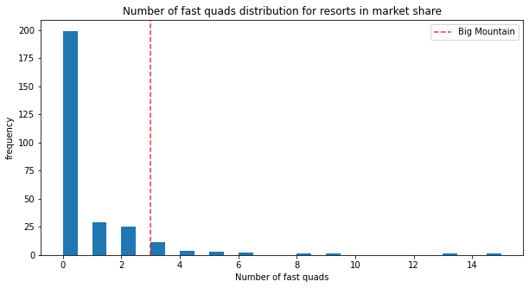
Fast Quads

Slide 7
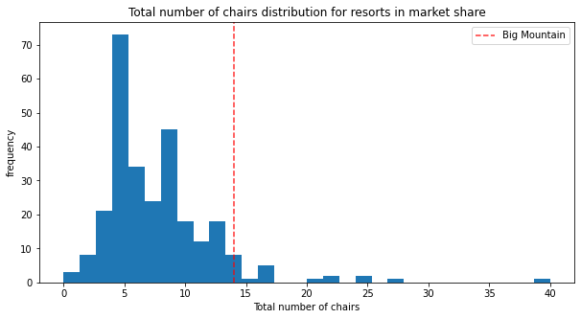
Number of Chairs

Slide 8
4 Options to Increase Revenue

Slide 9
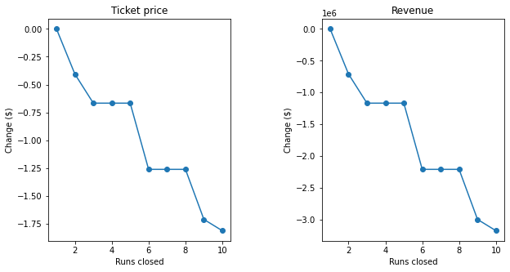
Option 1
The model says closing one run makes no difference. Closing 2 and 3 successively reduces support for ticket price and so revenue. If Big Mountain closes down 3 runs, it seems they may as well close down 4 or 5 as there's no further loss in ticket price. Increasing the closures down to 6 or more leads to a large drop.
Permanently closing down up to 10 of the least used runs.

Slide 10
Option 2
This scenario increases support for ticket price by $1.99
Over the season, this could be expected to amount to $3474638
Increase the vertical drop by adding a run to a point 150 feet lower down but requiring the installation of an additional chair lift to bring skiers back up, without additional snow making coverage.

Slide 11
Option 3
This scenario increases support for ticket price by $1.99
Over the season, this could be expected to amount to $3474638
Such a small increase in the snow making area makes no difference.
Same as number 2, but adding 2 acres of snow making cover

Slide 12
Option 4
This option does not produce a difference whatsoever.
Increase the longest run by 0.2 mile to boast 3.5 miles length, requiring an additional snow making coverage of 4 acres.

Slide 13
Conclusion

Slide 14
Recomendations
Increasing the vertical drop by 150ft supports raising the ticket price by $1.99
Our data analysis showed that Big Mountain could raise their prices by $14.87 based on comparisons with other resorts. If we subtract the error of $10.39 you could still safely raise prices by $4.48 to account for that.
A combination between Option 2 and the price increase stated earlier

